Slide 1

Decentralized Applications
Blockchain
Praveen Singh Rathore
20314802717
C-5
Computer Science Engineering

Slide 2
Contents
Blockchain
Types of Blockchain
Truffle IDE
Smart Contracts
Solidity and Remix IDE
Testing Smart Contracts
Basic Truffle Commands
MetaMask

Slide 3
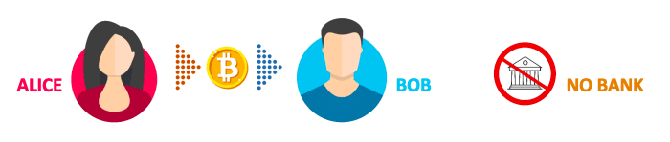
Blockchain
A blockchain is, in the simplest of terms, a time-stamped series of immutable record of data that is managed by a cluster of computers not owned by any single entity. Each of these blocks of data (i.e. block) are secured and bound to each other using cryptographic principles (i.e. chain).
The blockchain network has no central authority — it is the very definition of a democratized system. Since it is a shared and immutable ledger, the information in it is open for anyone and everyone to see. Hence, anything that is built on the blockchain is by its very nature transparent and everyone involved is accountable for their actions.
The Three Pillars of Blockchain Technology
The three main properties of Blockchain Technology which has helped it gain widespread acclaim are as follows:
Decentralization
Transparency
Immutability

Slide 4
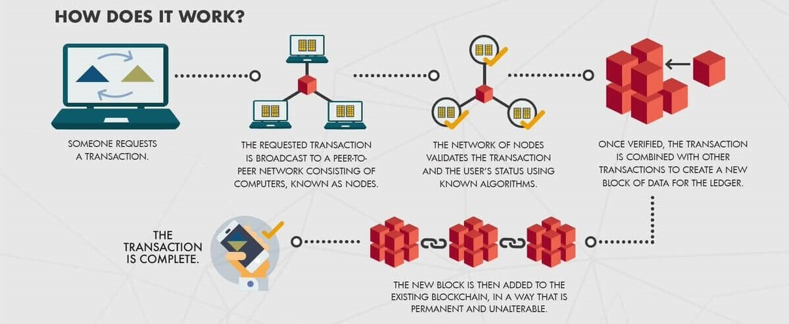

Slide 5
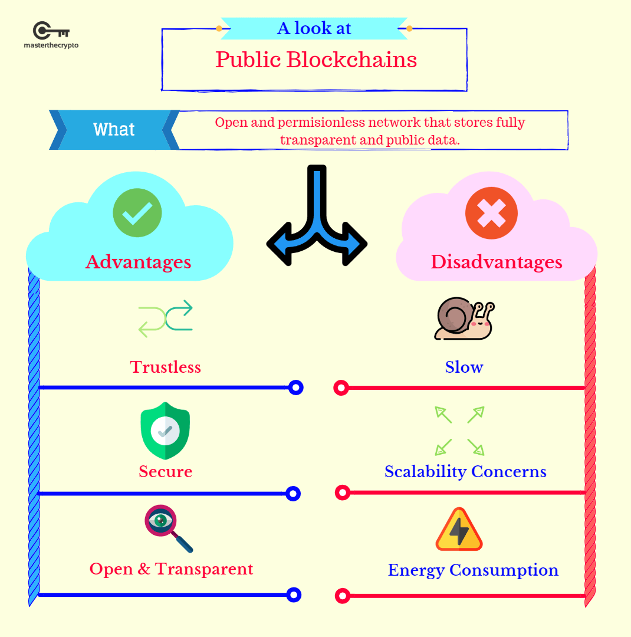
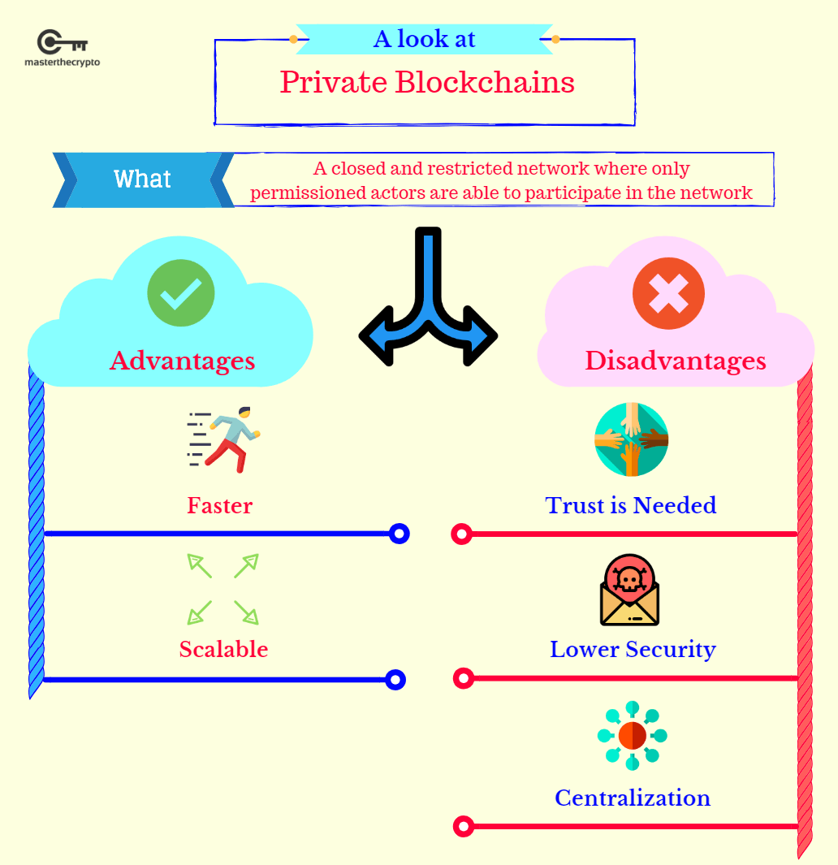
Types Of Blockchain
There are basically two types of blockchains-
Public Blockchain like Ethereum and Bitcoin. In the pursuit of decentralization, public blockchains are completely open and allow anyone to participate by verifying or adding data to the blockchain (a process called 'mining').
Private Blockchain like Hyperledger and R3 Corda. For participation in Private Blockchain a Membership Service is required.

Slide 6
Truffle IDE
It is a Development Environment, Testing Framework and Asset pipeline for Ethereum Blockchains.
With Truffle, you get: Built-in smart contract compilation, linking, deployment and binary management.
Steps for development of Decentralized Applications.
Install Truffle IDE on your system.
Create Smart Contracts in Solidity using Remix IDE.
Create a Test file for your smart contract.
Perform Smart contract testing
Install MetaMask plug-in on your browser.

Slide 7
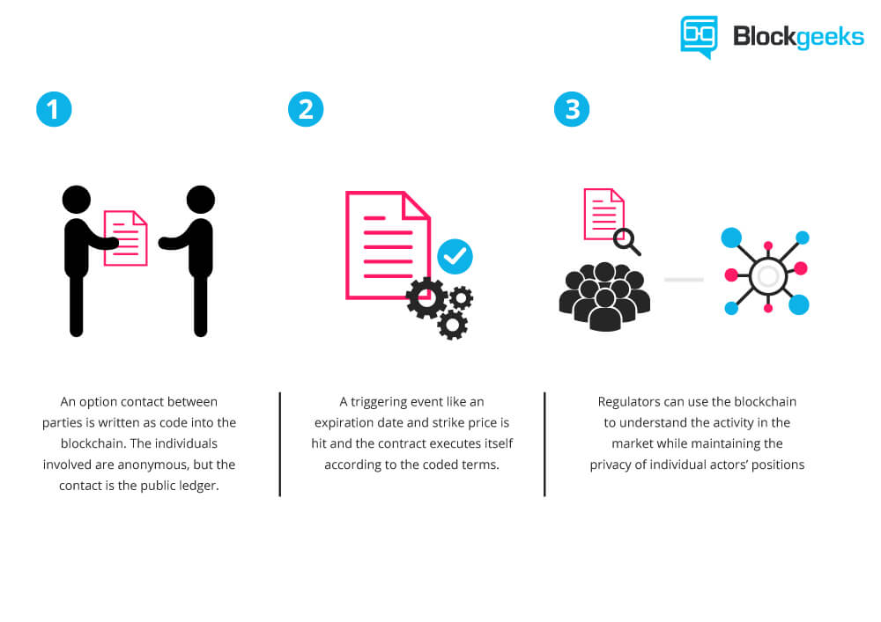
Smart Contracts
Smart contracts are a term that was coined by Nick Szabo in 1994. Smart contracts are the programs that we write on the blockchain and let us interact with it. The most powerful feature of a smart contract is the fact that once it is deployed on to the blockchain, it is immutable and you cannot go back and edit the programs.

Slide 8
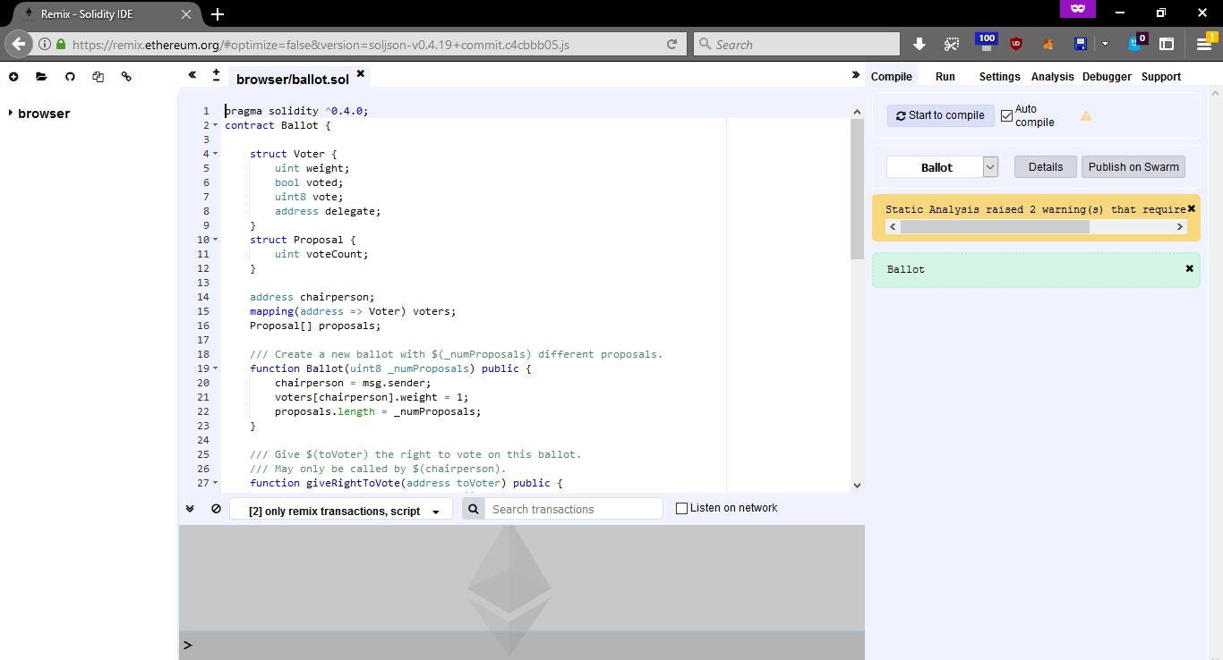
Solidity and Remix IDE
The ethereum foundation has released a cloud based IDE called Remix that is a simple way to get started.You see a screen on the left that lets you write code. The right hand side lets you deploy your code on the blockchain and lets you interact with the functions that you have written.
The simplest thing to do in any programming language is declare and write variables so let's see an example of how to do that:
pragma solidity ^0.4.0;
contract SimpleStorage {
uint storedData;
function set(uint x) {
storedData = x;
}
function get() constant returns (uint retVal) {
return storedData;
}
}

Slide 9
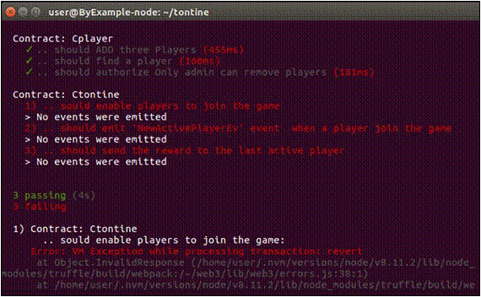
Test for smart Contracts
Testing is one of the most important — yet overlooked — aspect of the development of smart contract. Whenever you create a smart contract you have to make sure that it’s working properly and testing is the best way for using the contract in different situations without any risk.
The only way to fix a bug on a deployed smart contract is to deploy a new version of that contract; the old version with the bug will be still on the blockchain and it will remain there forever.
So testing the smart contract before deploying it will
make sure your functions will have the expected behavior.
Positive testing determines that your application works as
expected. If an error is encountered during positive testing,
the test fails.
This strategy is shown in the first part of the tutorial.
Negative testing ensures that your application can gracefully
handle invalid input or unexpected user behavior.

Slide 10
Basic Truffle Commands
truffle init - Initializing a template or a base directory structure for a Dapp .
truffle compile - This command is used smart contract compilation on the truffle Ide using terminal.
truffle develop - This command generates a Test Blockchain Server (Accounts).
truffle migrate - This command is used to Deploy the compiled smart contracts to the test blockchain server. Often we use the command truffle migrate--reset in order to overwrite any previously migrated contract on to the test server. This being a testing environment overwriting of the smart contract is allowed whereas it cannot be edited, i.e., it is immutable when deployed on a public blockchain.
truffle test - This command is used to create a testing environment for the deployed smart contract. A test file containing Positive and Negative tests, in this case coded in Javascript, should existin the base directory of the smart contract.

Slide 11
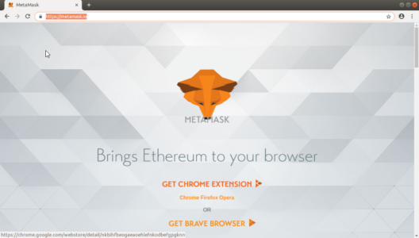
MetaMask
MetaMask is an easy-to-use browser plugin (for Google-Chrome, Firefox and Brave browser), that provides a graphical user interface to make Ethereum transactions. It allows you to run Ethereum DApps on your browser without running a full Ethereum node on your system. Basically, MetaMask acts as a bridge between Ethereum Blockchain and the browser. MetaMask is open-source and provides the following exciting features:
You can change the code of MetaMask to make it what you want it to be
Provides built-in coin purchasing
Local-key Storage
MetaMask in simple words is basically a wallet. A wallet in
Blockchain is used to store the user’s credentials.

Slide 12
ThankYou !!

